Slide 1
AFUA Implementation in Lower Airspace Through Modular Flexible Structures
by Ranko Vuica and Željko Savić
Croatia Control Ltd.

Slide 2
Introduction
COMMISSION REGULATION (EC) No 2150/2005 of 23 December 2005
„Flexible use of airspace is an airspace management concept described by the International Civil Aviation Organization (ICAO) and developed by the European Organization for the Safety of Aviation (Eurocontrol), according to which airspace should not be designated as either purely civil or purely military airspace, but should rather be considered as one continuum in which all users’ requirements have to be accommodated to the maximum extent possible.”
AFUA implementation in Lower Airspace through the Modular Flexible Structures
Project results: „New modular flexible environment in lower airspace supports various activities in airspace, extends new possibilities for airspace use to all kinds of users and at the same time positively influences the awareness and safety of all users.”

Slide 3
Users’ Perspective
Complexity of lower airspace
Airspace classes (G, C, D)
Airfield and aerodrome operations (CTR)
Non AMC-manageable military areas (P, R, D)
Various types of users
Military
Police
SAR
Sporting activities (gliding, paragliding, etc.)
General aviation
Balloons, free balloons, RPAS/UAS
Various needs
Permanent airspace (location and height) vs AD-HOC areas
Huge areas vs small areas
Adjustable airspace (lateral and vertical boundaries)
Time of use (seasonal, on weekends, daily, hourly)
Avoidance of the full area establishment process
Abuse of AD-HOC principles
Continuous renewal of the approval for AD-HOC-created areas (permanent areas)
Requested time of use
Not realistic (3 months SR – SS)
Uncertainty of operations
Tactical approval depends on the actual situation
Difficult planning process for other users
Uncertain real-time status of an area − (active, non-active)
Conflict resolving process
Unknown priority rules

Slide 4
Regulation and Status of ASM Organization
HLAPB
(ASM 1)
CIV AA
AMC
MIL AA
Regulation in place
ICAO, EU, national
ASM organization (by the book)
Concerns
ASM 1
Area establishment process was not suitable for user demands
ASM 2
AMC – civil-military coordination (mainly for commercial traffic and military areas)
CIV AA – AD-HOC approval by an ANSP via NOTAM for 3 months (SR – SS)
Pre-tactical approval process completely avoided (D-1) – conflicts on the day of activity
ASM 3
Tactical approval on the day of activity – increased workload for ATCOs, restrictions in approval or rejected requests
Actual status for planning purposes – unknown (ask a relevant ATC unit)

Slide 5
Assessment of Lower Airspace
Continuous growth of users demands
Uncontrolled "G" class of airspace limited to 1000 ft AGL
Published areas
Non AMC-manageable military areas (P, R & D)
Limited to small enclaves in the vicinity of airfields
Non-adequate for user needs
Process of establishing a new area
Duration of the establishment process
Pressure on the organization and ASM system (continuous impact & safety assessments)
Growth of requests for new AD-HOC areas on a daily basis
Gap in the regulation
Users avoiding the full establishment process for new areas
Continuous renewal of the approval for AD-HOC-created areas (permanent areas)
Procedures on a daily basis
Non-manageable areas
General announcement by NOTAM (SR – SS)
For actual activity? (contact the relevant ATC unit)
Safety concerns
Pre-flight briefing (someone may be there)
Actual usage and efficiency (unknown)
Education of users (workshops, panels, forums, etc.)
ASM tools and information dissemination
Information dissemination by NOTAMs (too many with a general time of activation)
Communication with the relevant ATC (by phone)
General approval (by fax or e-mail / on paper)

Slide 6
Preconditions for Implementation
MODULAR, FLEXIBLE ENVIRONMENT
ASM ORGANIZATION &
PROCEDURES
ASM TOOLS
ASM implementation at 3 levels
Civil-military coordination
CDM process established
Implementation and adjustment of the regulation
ICAO, EU and national
Priority rules
Airspace demand analyses
Actual user needs
Assessment of existing areas
Actual usage of existing areas and airspace
Existing procedures
LoAs
Procedures for fast CDM and booking processes
Safety concerns
Existing tools and means of communication
Real-time information about the actual airspace status
"Online" communication between the user and ASM
Enhanced planning process

Slide 7
New Deal with Users
Modular flexible structures – proposal
Defined net of modular flexible structures (segmented airspace)
Conducted Safety Assessment of segmented airspace and structures
Determined priority rules
AMC as a focal point at ASM 2 and ASM 3 levels
Responsible for management on a daily basis
Coordination between stakeholders
Implemented fast CDM process
Booking, activation and release procedures according to the FUA principles through ASM 2 and 3
Easily accessible ASM tool supporting the CDM process
Net of structures published in AIP and the ASM tool (AMC Portal)
Available to registered users according to the priority rules
D-1 reservation
ASM TOOL
D tactical approval
CDM
USERS
AA, AMC
FMP
ATC
CDM
USERS
CESUP,
AMC
FMP
ATC
Priority rules

Slide 8
Implementation Process
Changing the types of military areas
From non AMC-manageable P, R, D areas to the AMC-manageable TRA and TSA areas
Canceling all present civil areas for sporting activities
In respective airspace where new fragmented, modular, flexible structures are to be applied
Setting up a net of new fragmented, modular, flexible structures
Suitable for use by all users (civil or military)
Net of D-AMA, TRA and TSA AMC-manageable areas
Publication in the respective AIP and given to the AMC for day-to-day management
Regulatory framework adoption
To enable new procedures and supporting tools to be implemented
Implementation of new procedures through ASM tools in order to strengthen the execution of the new concept
Trial phase of the project
Measurement of key performance indicators
Implementation reassessment and the implementation of lessons learned
Operational use of new flexible, modular, fragmented areas on a daily basis
Continuous measurement of key performance indicators

Slide 9
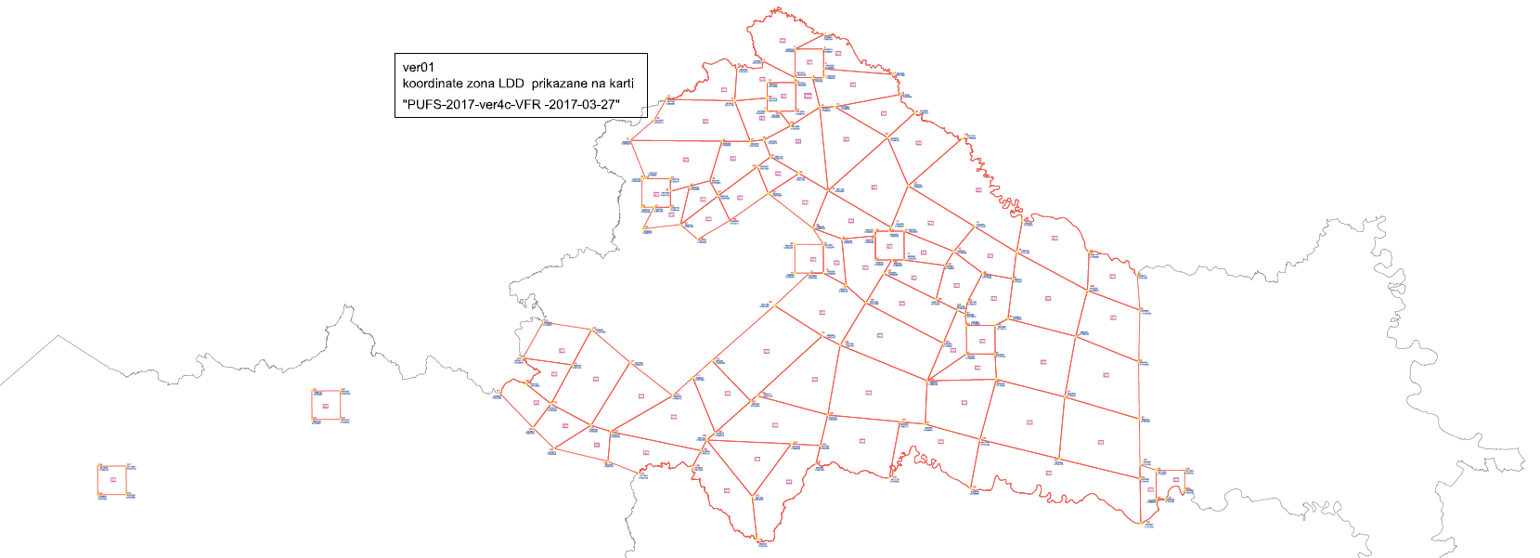
Design Methodology
Lateral fragmentation of airspace
Small areas (GND − 9500 ft)
Lateral boundaries designed on the known-landmark principles (VFR activities)
New net of areas
Suitable and available for various users and types of activities
3 possible area statuses (D-AMA, TRA, TSA)
based on the type of activity or minimum equipment requirement
Fast and efficient CDM process
Simple booking process
Defined rules of use, avoidance, transit (where applicable) and minimum equipment requirements

Slide 10
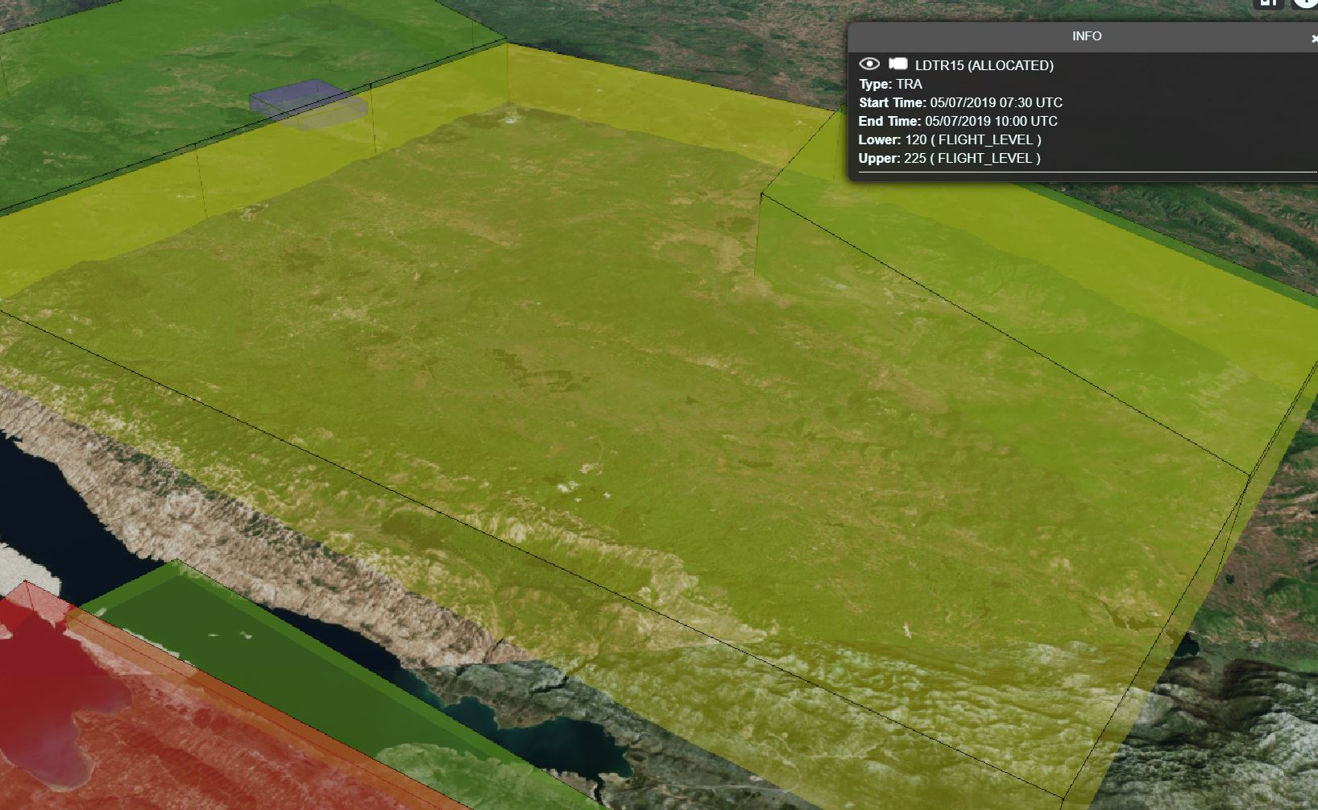
Purpose of Areas
D AMA
Applicable to all civil users who fly by the "see and avoid" principle
Class "G" airspace
Crossing of VFR traffic allowed with info about entering the "G" class airspace
TRA
Applicable to civil and military users equipped for the RMZ, TMZ
Airspace retains the class of airspace from which it is temporary segregated
Crossing of IFR possible after previous coordination
Crossing of VFR possible after previous coordination and if equipped with a transponder
TSA
Applicable to all users (mainly state users) who need a segregated area exclusively
Area manager is responsible for the safety within the area
Crossing is not allowed

Slide 11
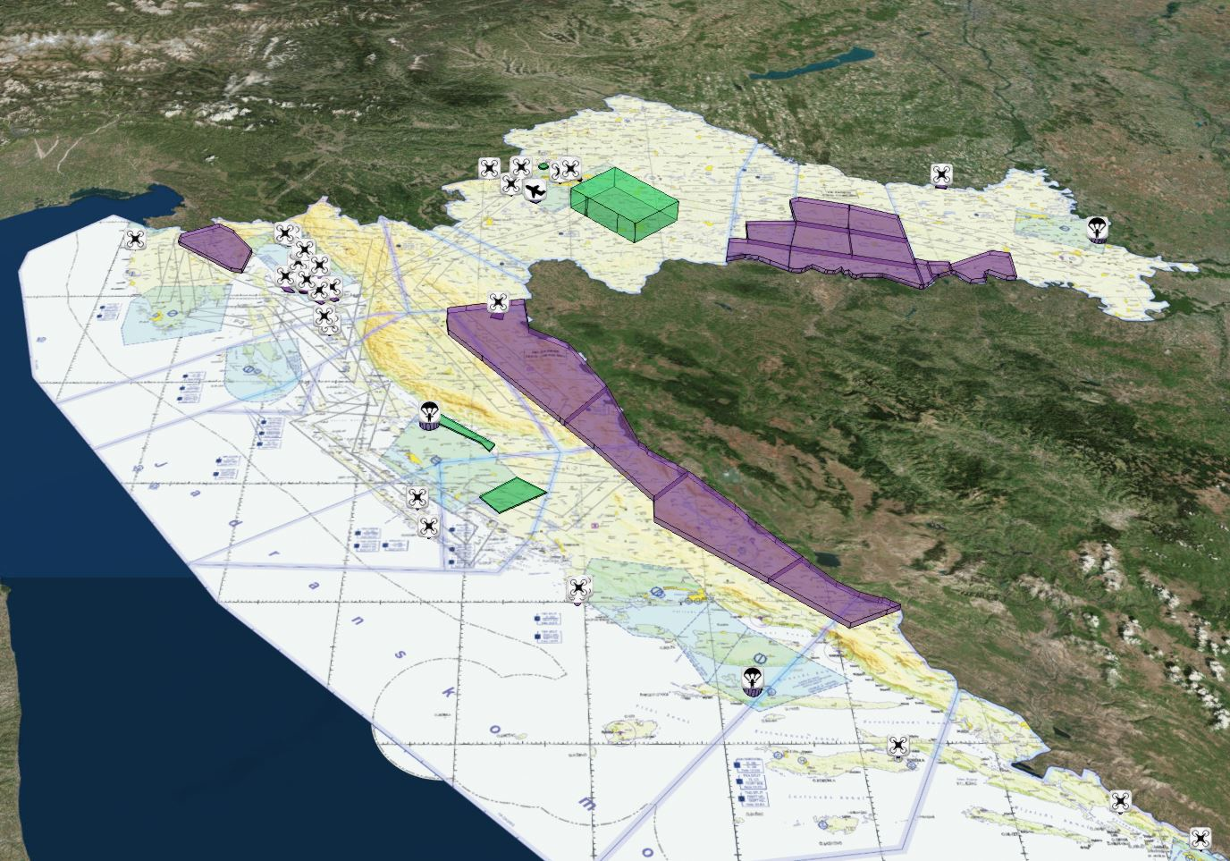
Gains of Modular Flexible Structures
FUA/AFUA implementation in lower airspace
More airspace available for users
Real-time information about segregations in airspace
Overview of the actual and planned situation in airspace
Overview of airspace available for booking (volume and time)
Simple and fast booking process (D-7 to D-1)
Realistic time of activation
Fast airspace release process after activity is completed
"Online" communication between users and the ASM through an ASM tool
Favorable ratio of the published and AD-HOC structures

Slide 12
Post-implementation Analysis
New areas are used everyday
Vicinity of airfields – maximum use
Connected structures for bigger events
Overflights between airfields and cooperation between users
Significant rise of sporting activities
Fast and safe segregation for military and police operations on demand
More efficient planning process
Planned/used
D-AMA areas ("class G") – mostly used
Simplicity of the process
Safety of all airspace users
CDM − Requested/approved/used

Slide 13
AMC Portal – Web Tool
Internet is a huge part of our life; why not use it for the benefit of all users on a daily basis
AMC PORTAL – current status
All information in one place, for everybody to see and use

Slide 14
Conclusion
FUA/AFUA implemented in entire airspace
Planning is realistic with a fast release process when there is no further need for segregation
Improved safety of all users
Airspace user
Available airspace for all kinds of activities based on the actual needs (D-AMA, TRA, TSA)
Increase in potentially segregated airspace in practice means an opportunity for greater airspace efficiency at allocation

Slide 15
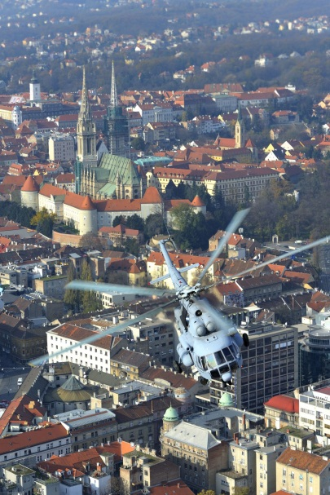
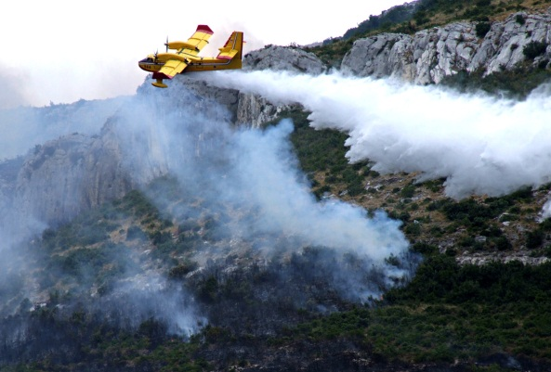
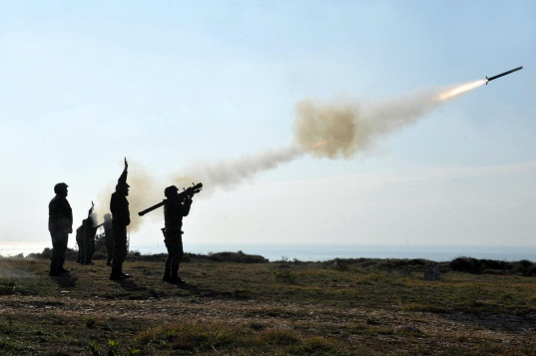
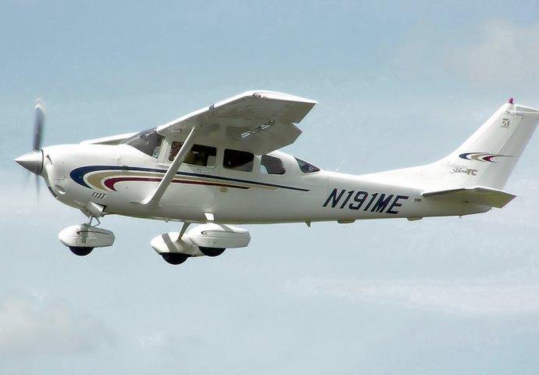
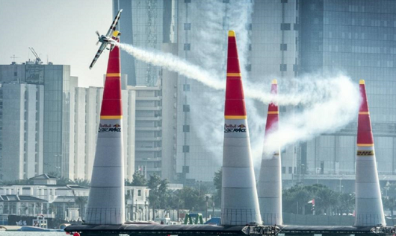
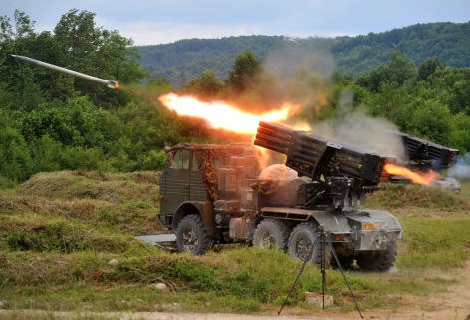
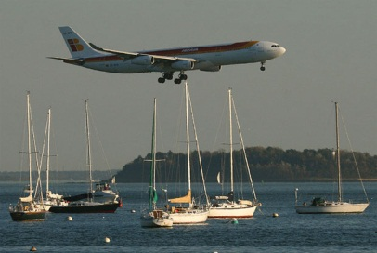
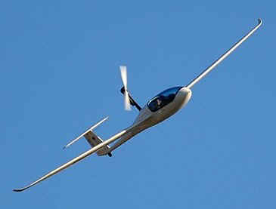
Q&A?
Thank you for your attention!

